Slide 2
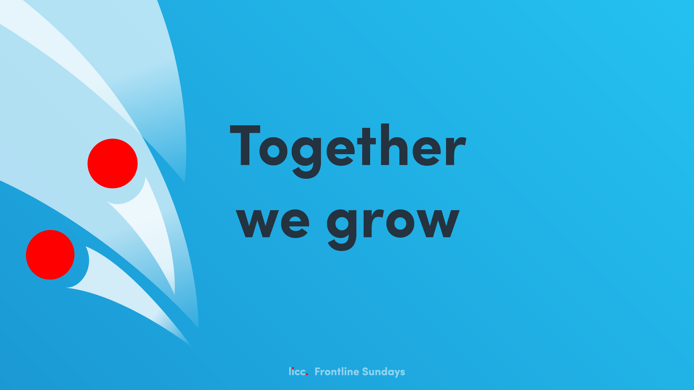
Hebrews 10v19-25

Slide 3

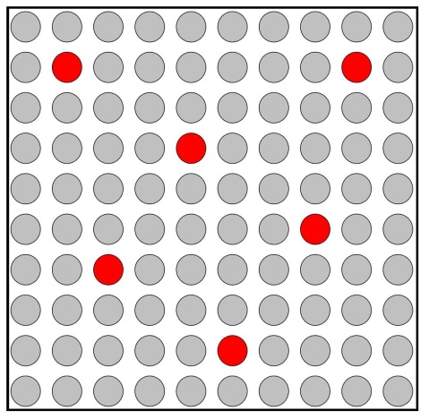
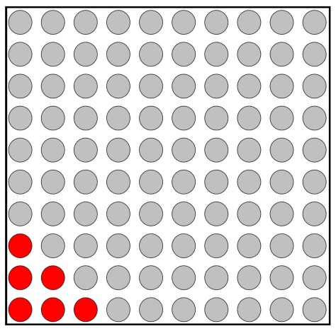
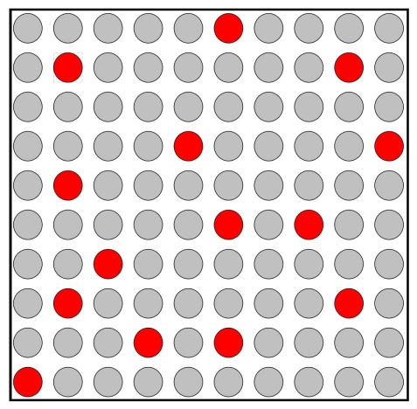
+
=

Slide 4
Romans 12:4-5 ⁴ For just as each of us has one body with many members, and these members do not all have the same function, ⁵ so in Christ we, though many, form one body, and each member belongs to all the others.
1 Corinthians 12:12-14 ¹² Just as a body, though one, has many parts, but all its many parts form one body, so it is with Christ. ¹³ For we were all baptised by one Spirit so as to form one body – whether Jews or Gentiles, slave or free – and we were all given the one Spirit to drink. ¹⁴ And so the body is not made up of one part but of many.

Slide 5
It all starts with God…
Our whole lives are lived in response to what God has done for us through Jesus Christ.

Slide 6
3 things we can help one another do…
Hold on to hope together
Spur one another to good works
Keep meeting together

Slide 7
Hold on to hope together v23
Draw near to God
Assurance of our faith
Experience peace

Slide 8
Spur one another to good works v24
Inciting or provoking…
Growing weary of doing good?
What might this look like in TRBC
How do we do it already?
How might you do it more?
What do we do or learn together that helps us when we are apart?

Slide 9
Keep meeting together v25
Getting the balance right.
If this is…
The gathered worship life of our church is where we teach, guide, challenge, equip, encourage, love, and commission one another for our lives on the frontline.

